Slide 1
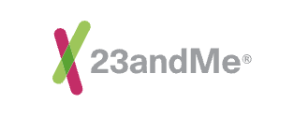
What Led Me to
Freeman Lewis
Florida International University
December 7th 2022
Notes:
Good morning, everyone, thank you for joining my seminar. My name is Freeman Lewis, and I am speaking with you all as an interviewing candidate for the available Therapeutics Development Summer Internship role. My seminar is title What Led Me to 23andMe and what I aim to communicate to you today is how my scientific journey led me to interests in this internship role.

Slide 2
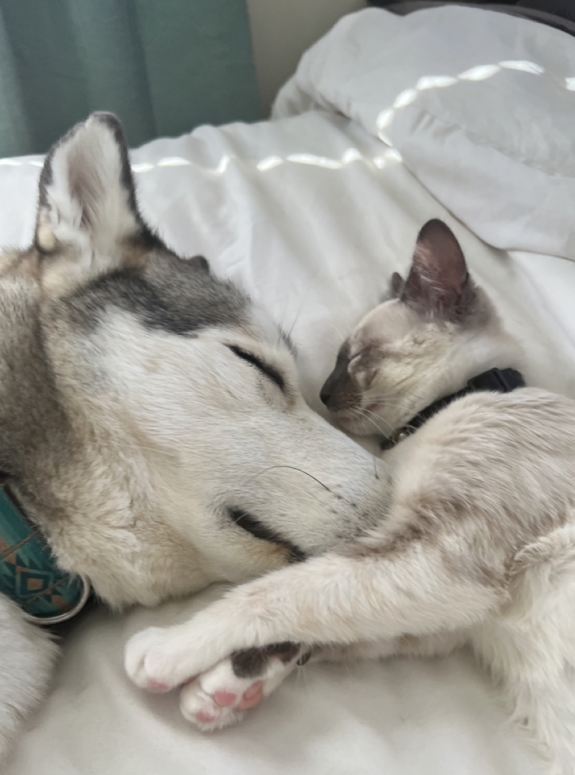
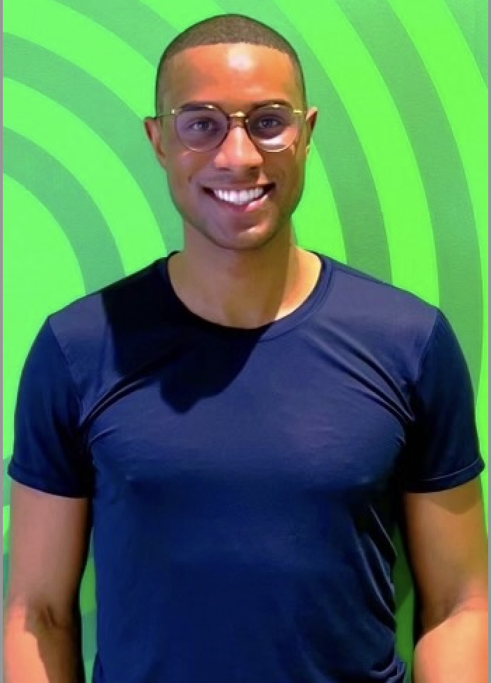
Virtual Introduction
Born in Oakland, CA
(B.S.) University of California, Davis
Physiological Psychology (2013)
(MPH) Tulane University SPHTM
Social, Behavioral, and Population Science (2022)
1st Year Doctoral Student Florida International University
Environmental Health Sciences (2022-2026)
Notes:
Before I begin explaining my journey, I would like to virtual introduce myself. I was born in Oakland CA and grew up in Berkeley CA. I am the youngest of 2 siblings, an uncle to three, and currently raising a 4-year-old Siberian Huskey and 1 year old Siamese kitten. I received my Bachelor of Science from the University of California Davis in Physiological Psychology with an area of Emphasis in Neurology Physiology and Behavior. This concentration focused on brain and CNS driven physiological changes that occur in mental health illness as well as metabolic disorders and aging. I’ve also received a Masters in Public Health from Tulane University School of Public Health and Tropical Medicine with an area of emphasis in Social, Behavioral, and Population Sciences. My masters was focused on identifying population level public health issues and using theoretical frameworks to devise health interventions and communication strategies to elicit positive health behavior changes. The program focused largely on health inequities and ensuring the health promotion was equity driven. Currently I am a first year, first semester doctoral student at Florida International University studying Environmental Health Sciences with an area of emphasis in Neurotoxicology. The program aims to understand, prevent, and treat Brain and CNS pathologies and understand how environmental factors may contribute to the development of said pathologies.

Slide 3
Seminar Outline
Professional
Research Experience
Masters Thesis Research
Doctoral Dissertation Interests
23andMe Internship Opportunity
10 year Career Development
(2012-2022)
Notes:
In today's seminar, I would like to detail my career development over the course of the last decade. By doing so, I hope to create a journey map that highlights pivotal experiences that better explains my interests in 23andMe. I will begin by explaining my past professional research experiences at UC Davis MIND, Genentech, and Calico. Next, I will communicate a high-level overview of my Masters Thesis Research at Tulane University. Following, I will provide my current doctoral dissertation interests. I would like to note that these are my current doctoral dissertation interests as a first semester doctoral student and that these interests are constantly evolving. I am sure after my discussion with you all today that my dissertation interests will undergo another iterative event; however, I would like to still provide my current foundational ideas. And lastly, I would like to explain how I see 23andMe furthering my dissertation research and career growth and highlight what learning opportunities I believe 23andMe could afford me. I would like to point out that as a first semester doctoral student, I will not have data to present from my dissertation work, nor my first lab rotation. But I will present data from publications of research where I participated or data from publications that were used to execute my work.

Slide 4
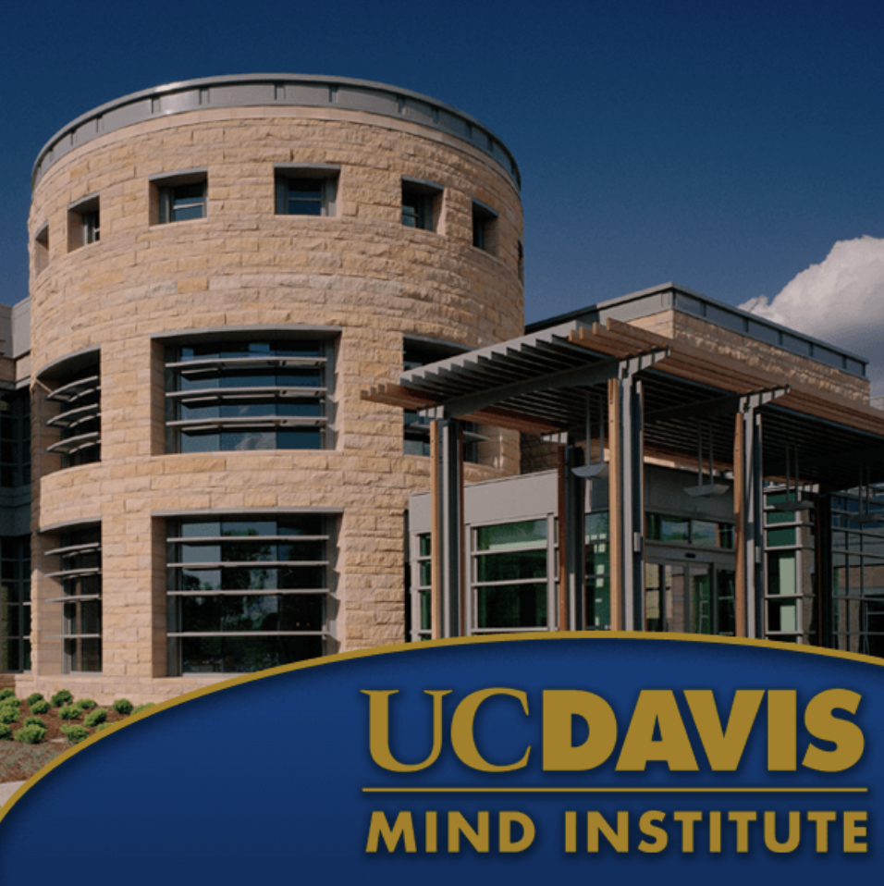
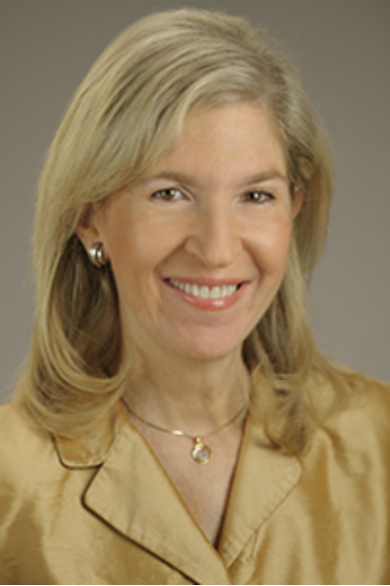
Professional Research Experience (2012-2015)
Robert E. Chason Chair in Translational Research, MIND Institute
Professor, Department of Psychiatry and Behavioral Sciences
University of California Davis School of Medicine, Sacramento
Dr. Jacqueline Crawley’s laboratory focuses on the development and translational application of mouse models of autism spectrum disorders to test hypotheses about how autism develops and to evaluate potential pharmacological treatments.
Notes:
My journey map begins in my last year of undergraduate study at the University of California, Davis. I was enrolled in a Physiological Psychology course in which Dr. Jacqueline Crawley provided a seminar talk. Dr. Crawley highlighted the work in her lab and welcomed undergraduate students to apply for an open internship opportunity within her lab. I did so and was selected to help quantify and annotate mouse ultrasonic vocalizations. I did not understand the relevance of ultrasonic vocalizations at that time but as I continued in her lab, I came to understand the significance of Dr. Crawley’s research.
Dr. Crawley’s laboratory focused on the development and translational application of mouse models of autism spectrum disorders to test hypotheses about how autism develops and to evaluate potential pharmacological treatments. In particular, Dr. Crawley was interested in the genetic causes of Autism and as candidate genes associated with autism spectrum disorders were identified, Dr. Crawley would generate mice with the targeted mutation and behaviorally phenotype through a battery of test for the autism relevant phenotypes. These mouse models served as useful translational tools to test hypotheses involving single genes, chromosomal locus deletions, copy number variants, environmentally induced changes in gene regulation, neuroanatomical abnormalities, environmental toxins, diets, immune dysfunctions, and other proposed causes of autism.

Slide 5
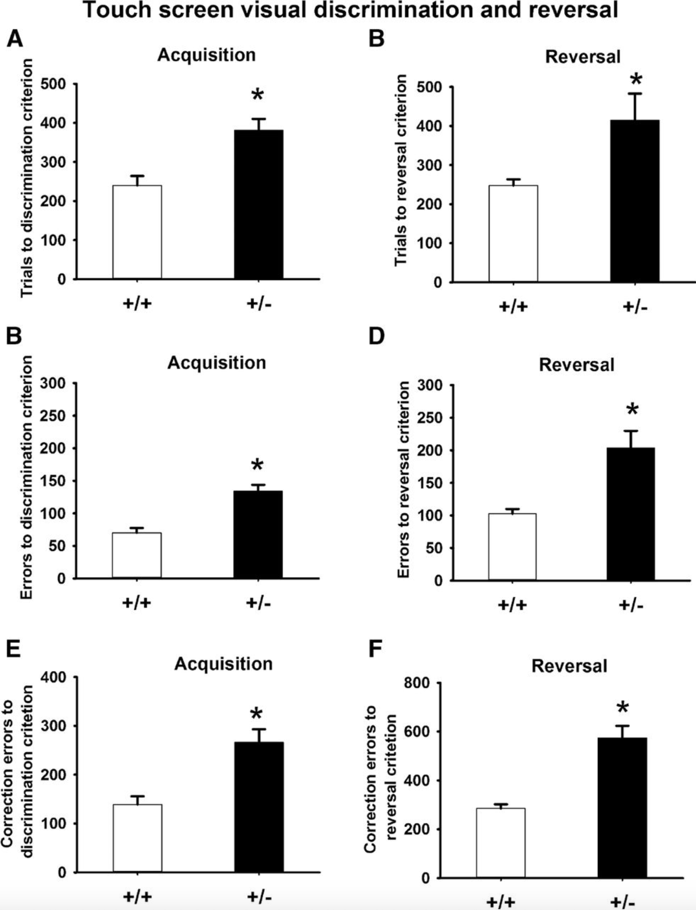
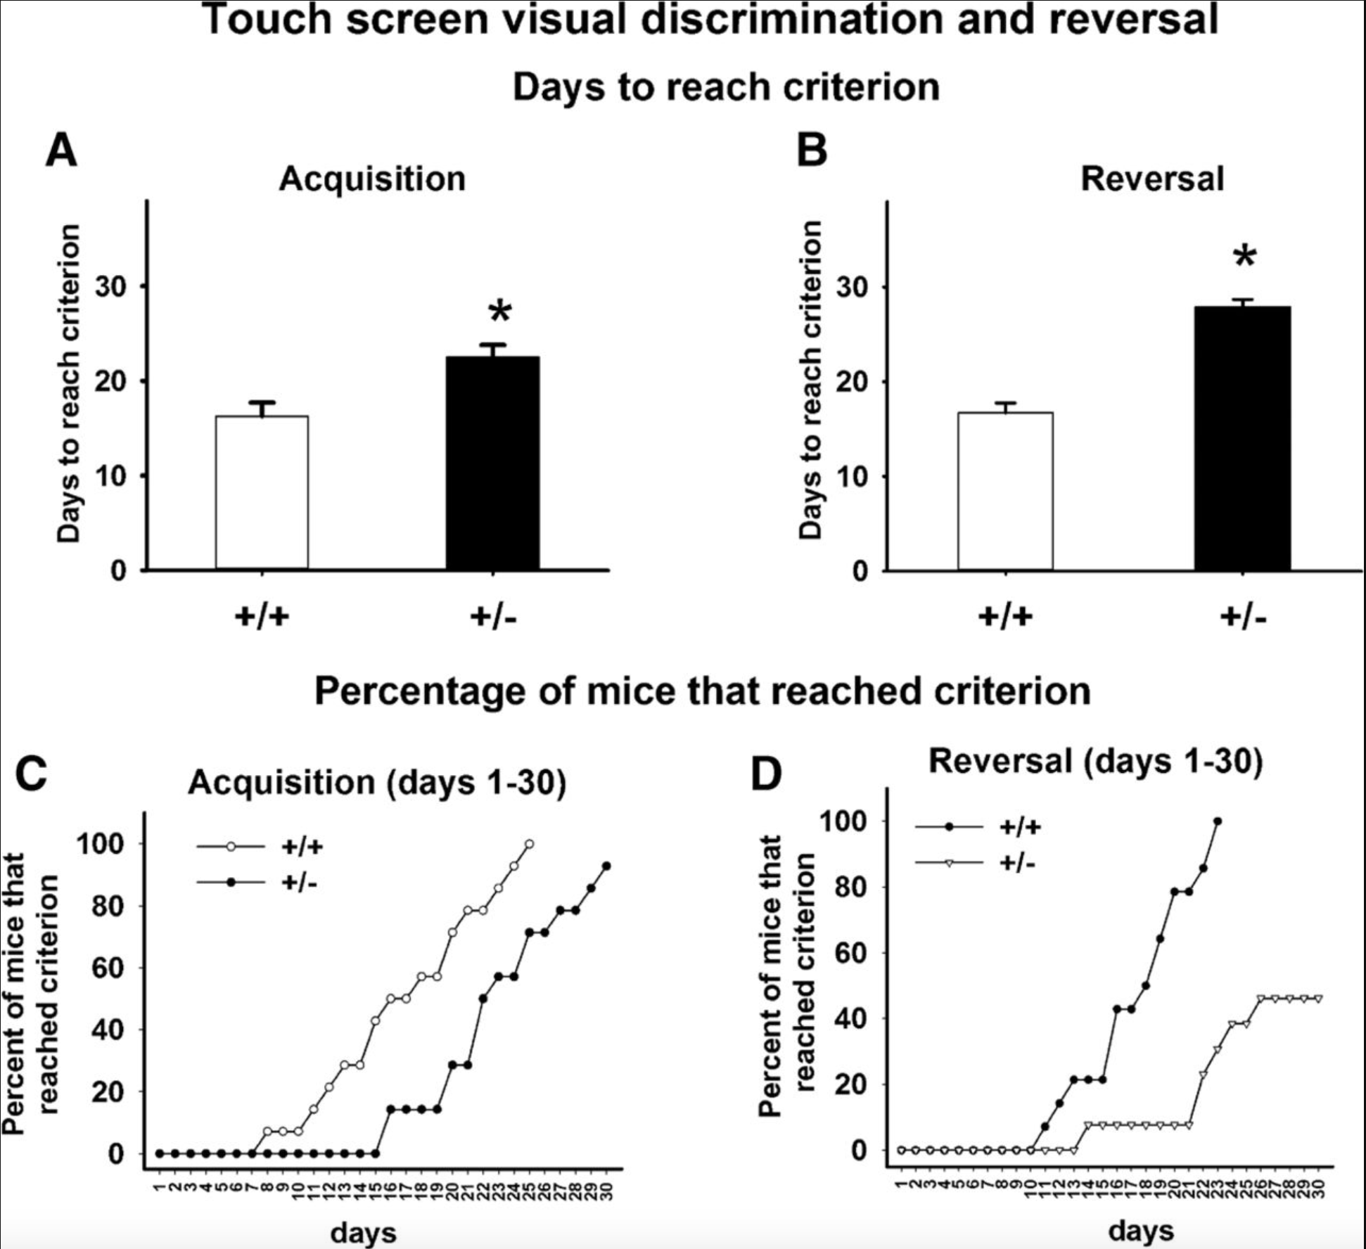

16p11.2 Deletion mice display cognitive deficits in touchscreen learning and novelty recognition tasks
Yang M., Lewis F., 2015
Notes:
During my time in Dr. Crawley’s lab, I worked closely with Adjunct Professor Dr. My Yang to behaviorally phenotype a novel transgenic mouse model with a Chromosomal 16p11.2 deletion. In children, the Chromosomal 16p11.2 deletion syndrome frequently presented with intellectual disabilities, speech delays, and autism phenotypes. In this paper published in Learning and Memory we investigated the Dolmetsch line of 16p11.2 heterozygous (+/2) mice on a range of cognitive tasks. Although not shown here, we found robust novel object recognition deficits confirming previous findings along with a similarly robust deficit in object location memory indicating impaired spatial novelty recognition. Most notable from our work was the identification of a cognitive deficit in touchscreen learning shown here. At the time touchscreen technology was cutting edge and it allowed for cognitive assessment of mice through a battery of tests evaluating different aspects of learning and memory.
Explain graphs….

Slide 6
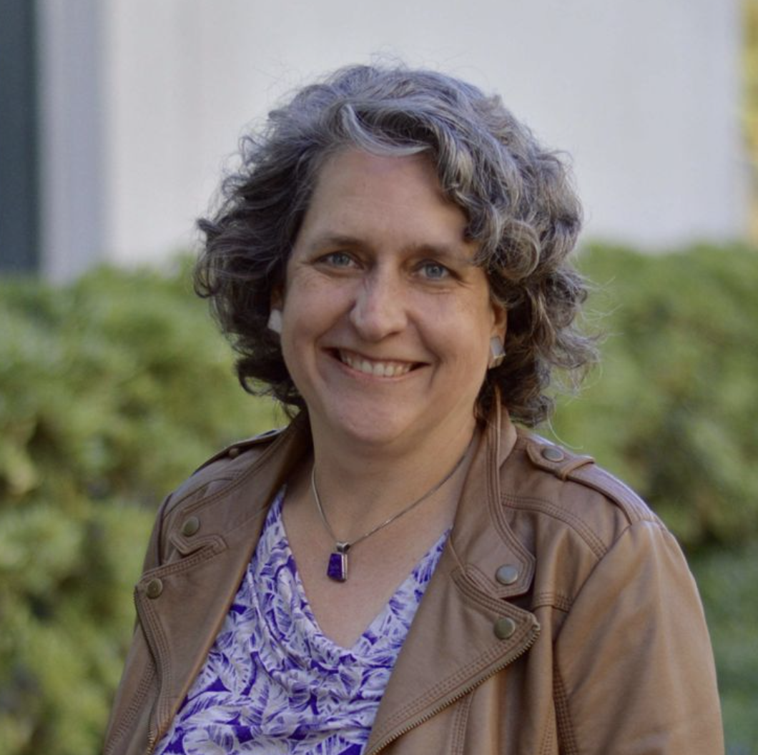
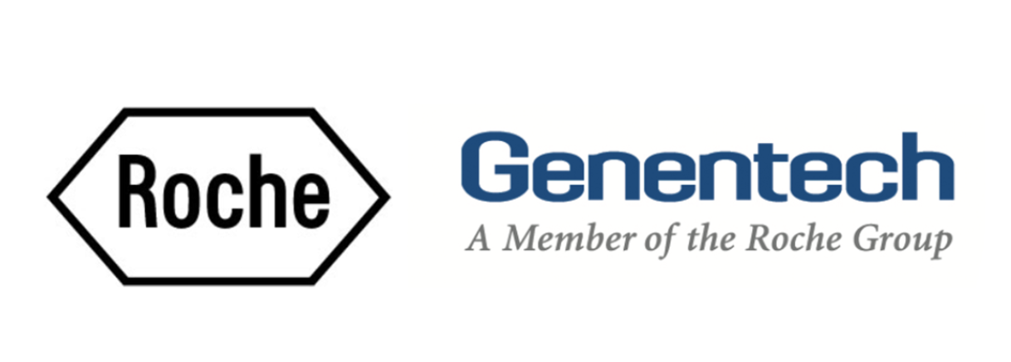
Professional Research Experience (2015)
Dr. Kimberly Scearce-Levie, Director at Genentech, led the pre-clinical translational neuroscience group and conducted research in neurodegenerative and neuropsychiatric diseases.
Notes:
Due to Dr. Yang and I’s publication and the popularity of Touchscreen technology in evaluating mouse cognition at that time, an opportunity to intern within the Neuroscience Department at Genentech under the supervision of Dr. Martin Weber and Dr. Kimberly Scearce-Levie presented itself. At that time, Dr. Kimberly Scearce-Levie was a Director leading the pre-clinical translational neuroscience group whose research focused on neurodegenerative and neuropsychiatric diseases. Dr. Scearce-Levie was interested in touchscreen technology to assess Alzheimer's related phenotypes in the APP/PS1 mouse model. Touchscreen technology was uniquely perfect for the assessment of cognition in this model because these mice suffered from axonopathies which caused motor deficits rendering conventional tests of memory unusable.

Slide 7
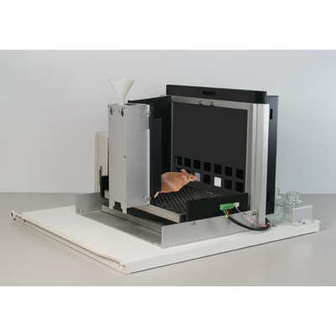
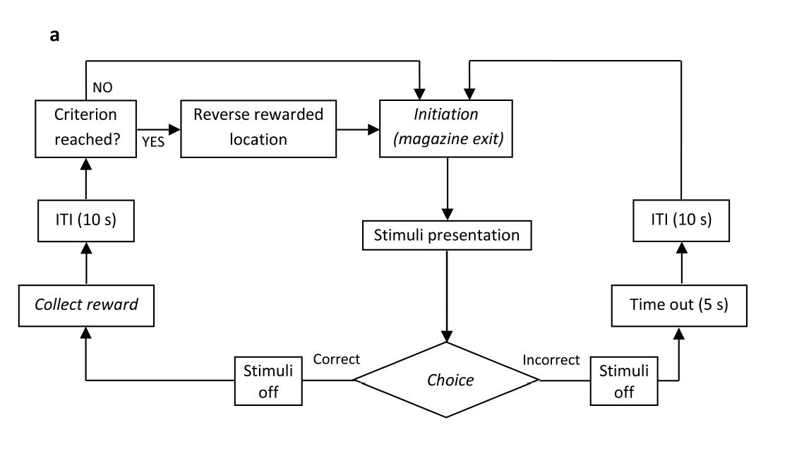
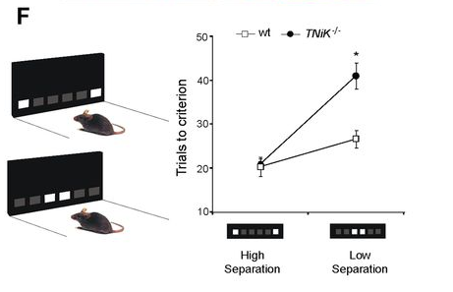

Bussey/Saksida touchscreen operant platform for testing working memory and pattern separation in rats and mice
Flowchart overview of the intermediate training and performance probe phases of the location discrimination (LD) task
Oomen et al., 2015
Notes:
To that end, I moved to San Francisco and spent 5 months developing touchscreen technology in-house for the Neuroscience Group. My project included the validation of a location discrimination task utilizing touchscreen technology. Once validated, the location discrimination task was used to evaluate dentate gyrus function (more broadly hippocampal spatial memory) in their Alzheimer’s mouse model.
Explain the graphs…

Slide 8
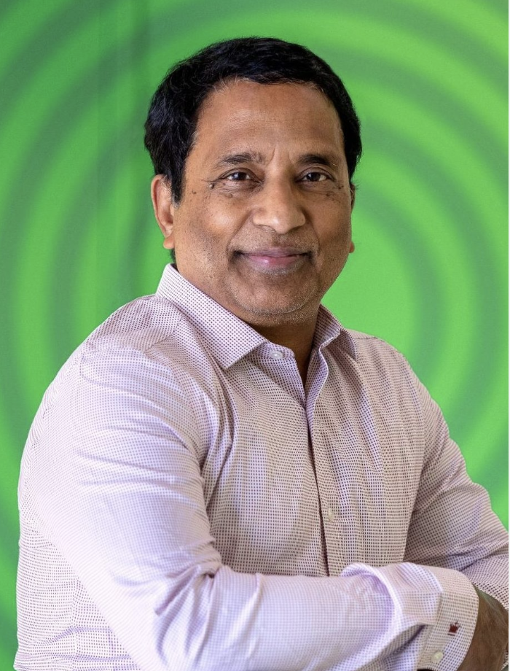

Professional Research Experience (2015 - 2022)
Dr. Ganesh Kolumam leads Calico’s Physiology group, consisting of members with multidisciplinary expertise in preclinical drug discovery research and development. His team develops preclinical models to gain a deeper understanding of disease pathophysiology and performs proof-of concept studies through target validation using various cutting edge molecular and biochemical approaches.
Notes:
After completion of my internship at Genentech, I leaned on the internal network and was made aware of a new opportunity at a Start-Up that was searching for behaviorist who had experience with mouse models. I did not know what I was getting myself into; but, I applied and sure enough received the chance to interview. In the early days at Calico (2015) we did not have labs and I built the Physiology departments research capabilities with my colleague Baby Martin-Mcnulty. Our role at that time was to assist in the collection of preclinical data to further or drug development efforts. Majority of our work focused on evaluating the safety profile of our lead compound (eIF2B). Over the years our team grew along with our responsibilities to include disease modeling. Today, Dr. Ganesh Kolumam leads the Physiology group, and the team consisting of members with multidisciplinary expertise in preclinical drug discovery research and development. Our main objectives were to develop preclinical models to gain a deeper understanding of disease pathophysiology and perform proof-of concept studies through target validation using various cutting edge molecular and biochemical approaches. From 2018 – 2022, I led the development of large-scale multi-tissue bulk and single cell RNAseq workflows to assist research and development efforts within the In Vivo Physiology team. The development of these workflows required an iterative processing mindset involving in vivo disease modeling and subsequent RNA isolation optimization. As a group we were able to leverage next generation sequencing as a discovery tool for complex phenotypes including, neurodegeneration, muscle atrophy, and metabolic syndrome. My workflow continues to be used to assist in achieving Drug Development corporate goals which includes identifying biomarker(s) in human specimens and generating preclinical data that would support there use as a tractable clinical biomarker(s) for new disease indication.

Slide 9
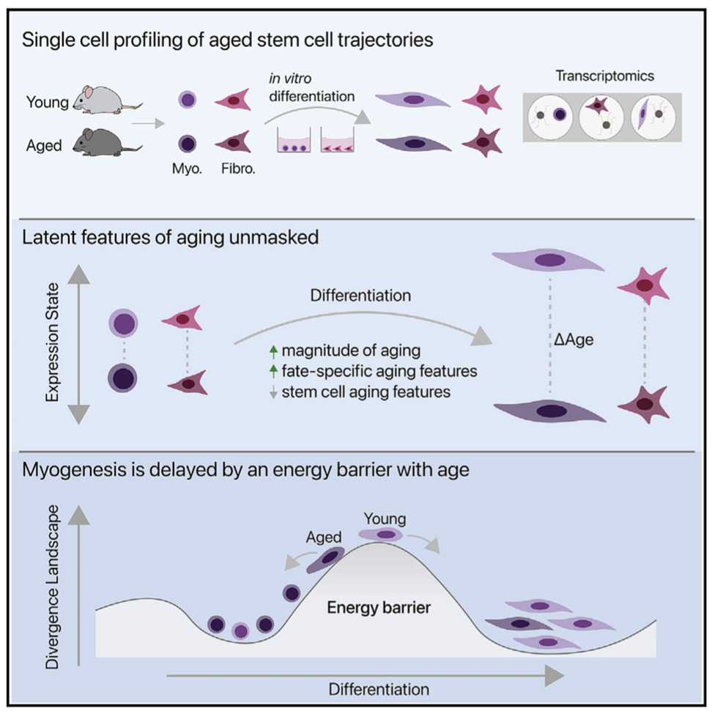
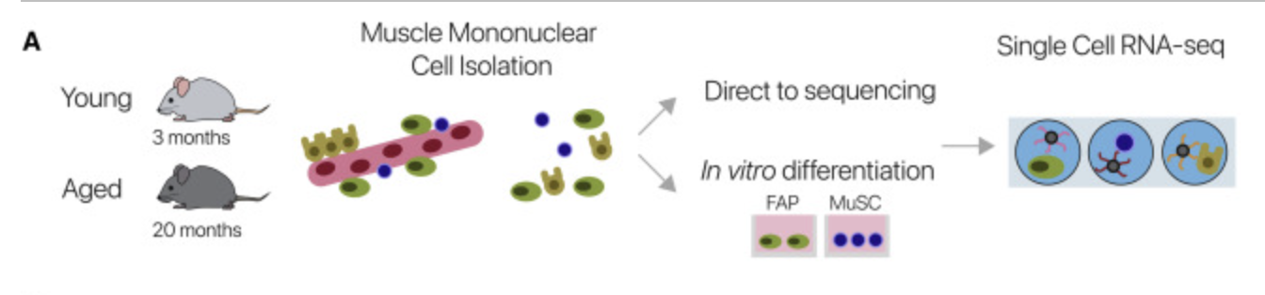

Differentiation reveals latent features of aging and an energy barrier in murine myogenesis
B
Kimmel et al., 2021
Notes:
Most notable was my workflows contribution to a recent publication by Dr. Jacob Kimmel in Cell Reports. We utilized my workflow to isolate muscle mononuclear cells from young and aged mice followed by single cell RNA sequencing. We found that aged MuSCs follow the same differentiation trajectory as young cells but stall in differentiation near a commitment decision. Our results suggested that differentiation reveals latent features of aging and that fate commitment decisions are delayed in aged myogenic cells in vitro. We were proud of our work and the success of the workflow, but everything came to a halt as the global pandemic hit.

Slide 10
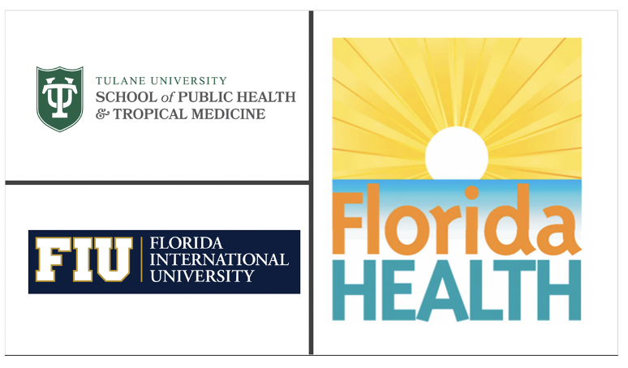
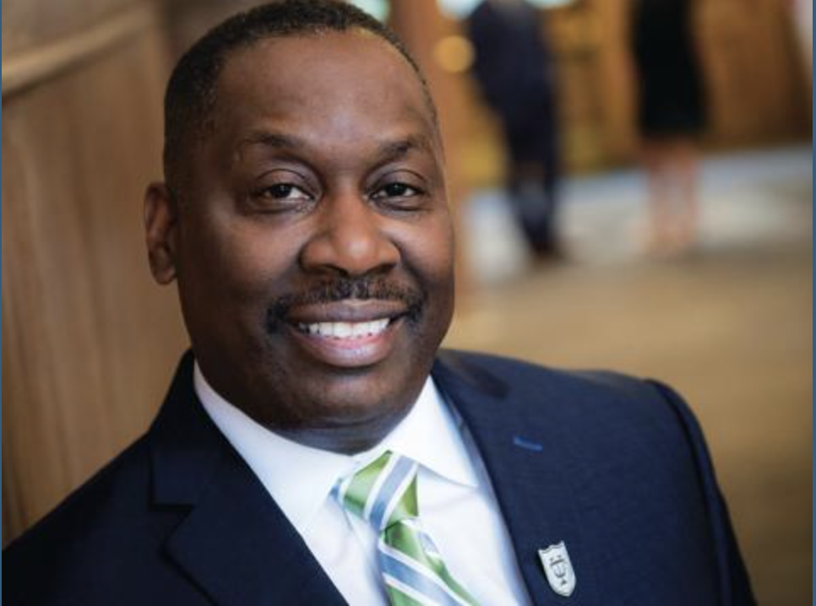
Masters Thesis Research (2020 - 2022)
Dean LaVeist heads the social, behavioral, and population science program which trains applied methods to health interventions and etiologic research at the individual, community, and societal levels. This program investigates the behavioral, social, and structural underpinnings of health inequities, and potential solutions to address them.
Notes:
During the height of the pandemic my sister gave birth to my first nephew, Giovanni Vance. Although there were very few positives to look forward to, my family and I were overwhelmingly excited; however, I, like many other families who, was concerned for Giovanni's development as the pandemic necessitated us to quarantine and maintain physical distance indefinitely. My concern derived from my belief that environmental influences during critical early developmental periods cause epigenetic changes that may last a lifetime. Quarantining at home and witnessing the inequitable effect the pandemic had on minority populations led me to a call to action and I began to consider my career passion. I recognized that I had an affinity for methods in genetic epidemiology and hypothesized its use as a way to improve social determinants of health within minority communities.
With this in mind, I was drawn to Tulane University by way of an NPR interview in which Dean Thomas LaVeist posed 3 questions:
What are the social and behavioral factors that predict the timing of various related health outcomes (e.g. access and utilization of health services, mortality, entrance into nursing home?)
What are the social and behavioral factors that explain race differences in health outcomes?
What has been the impact of social policy on the health and quality of life of Minority Populations?
In Fall of 2020 I enrolled at Tulane University under the guidance of Dean LaVeist. Dean LaVeist heads the social, behavioral, and population sciences program which trains applied methods to health interventions and etiologic research at the individual, community, and societal levels. His program trained me to investigate the behavioral, social, and structural underpinnings of health inequities, and potential solutions to address them.

Slide 11
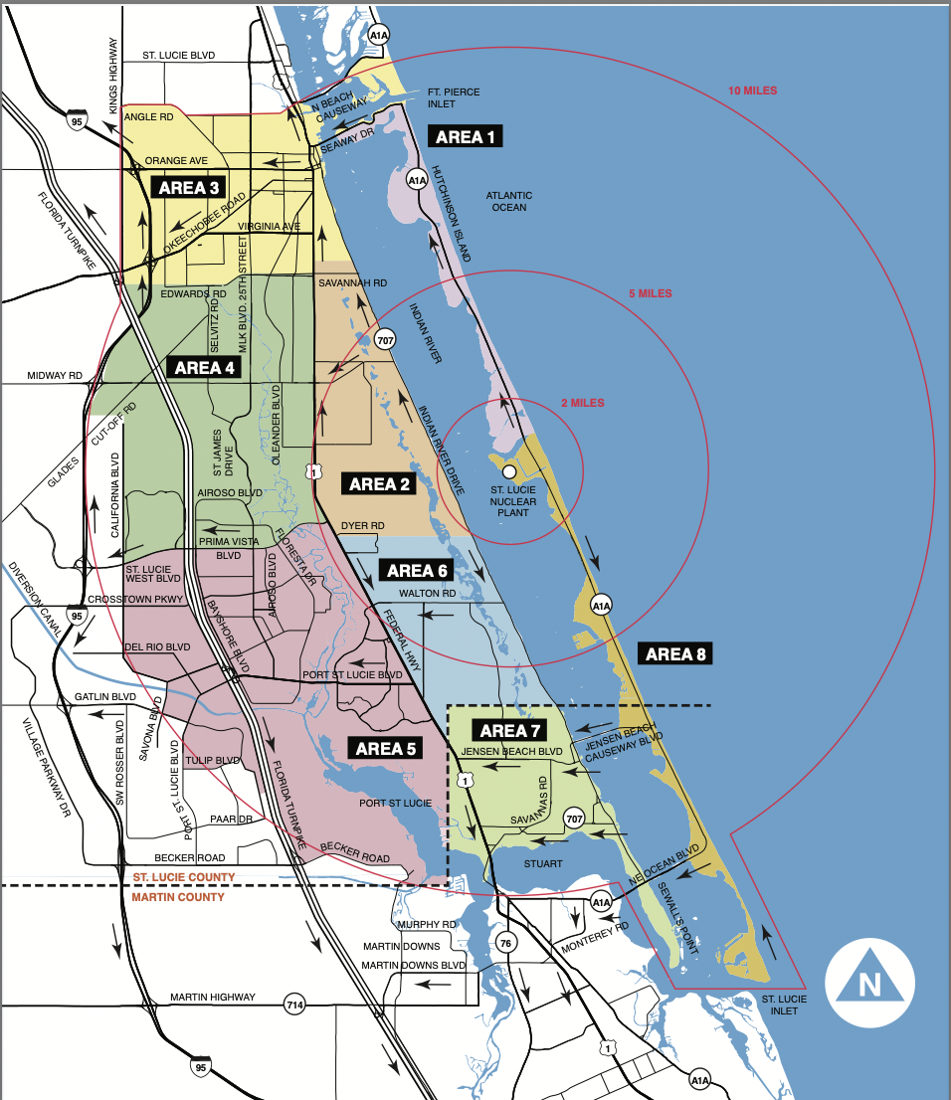
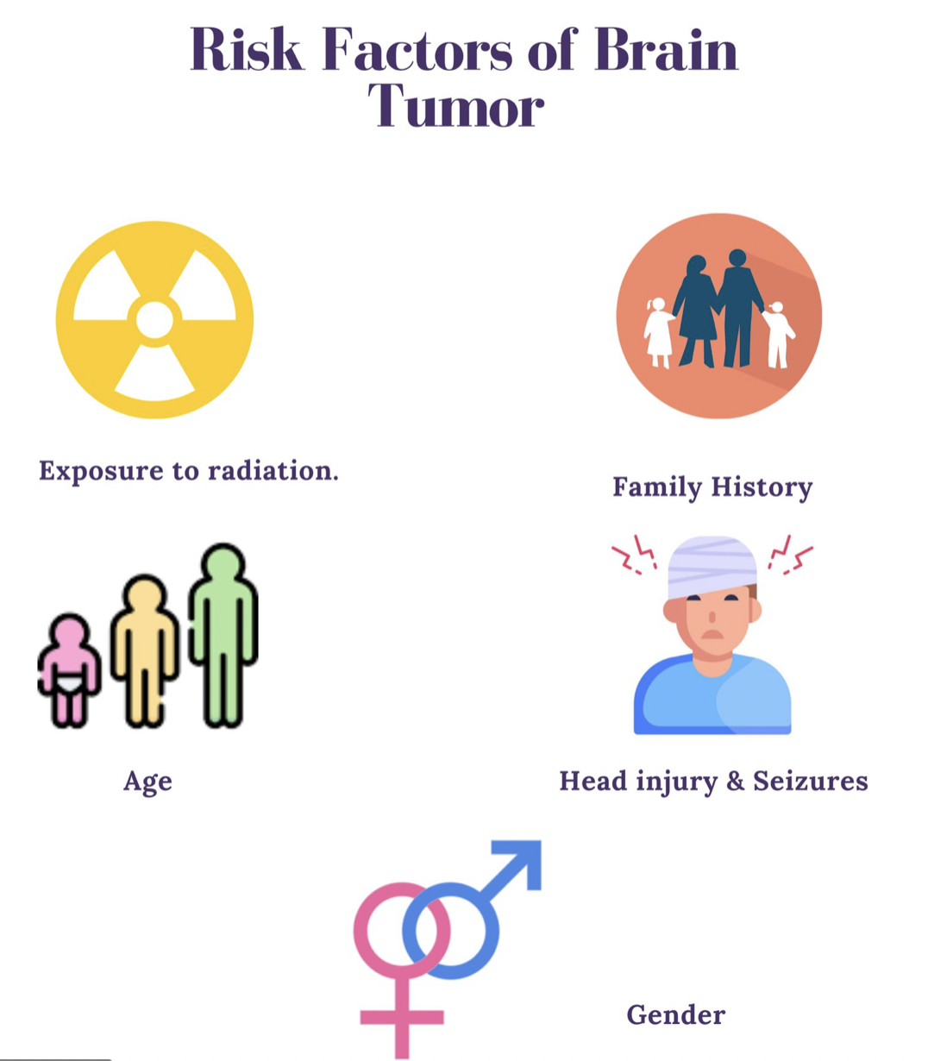
Biomedical Health Burden of Glioblastoma (Florida)
In Florida, glioblastoma incidence rates have remained relatively constant over the last two decades. On average in Florida:
Approximately, 3-4 cases per 100,000 population occur per year
More cases occur among non-Hispanic White males
More cases occur among individuals over 60 years of age
Tamimi et al., 2017
Notes:
For my master's thesis, I chose to focus on the general public's social perceptions of public health officials. At this time, vaccine hesitancy was a major topic of conversation and there were countless reports of misinformation convincing populations that vaccines were bad. Instead of choosing COVID as my topic I decided to focus on a population of individuals in St. Lucie County, Florida, who were convinced that Glioblastoma incidence was higher within their community although data suggested otherwise. Their beliefs were that they were being exposed to radiation runoff from the offshore St. Lucie Nuclear Power Plant. In collaboration with Florida International University, The Florida Department of Health, Bureau of Radiation Control I was able to obtain radiological data from the St. Lucie Plant Radiological Environmental Monitoring Program The data obtained through the St. Lucie Plant Radiological Environmental Monitoring Program verified that the levels of radiation and concentrations of radioactive materials in the environmental samples, representing the highest potential pathways to members of the public, had not increased and that measured exposure rates were consistent with exposure rates that were observed during the pre-operational surveillance program.

Slide 12
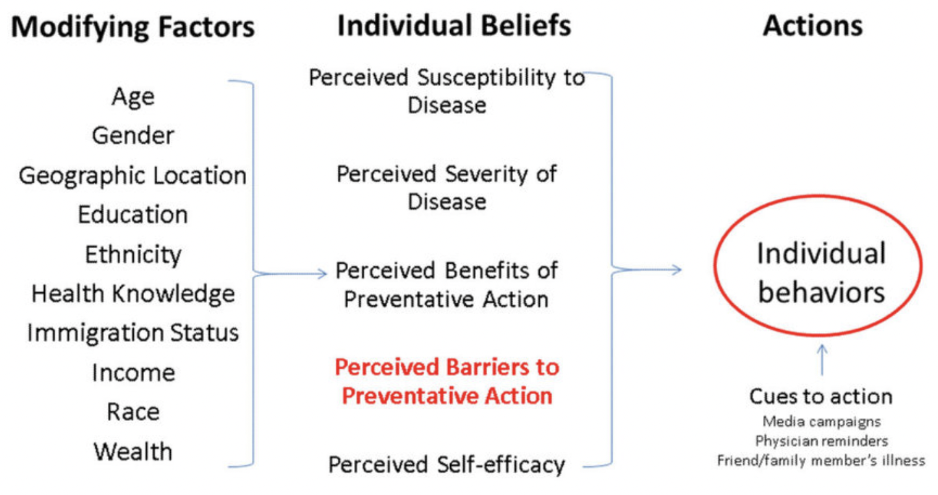
Social Media Campaign - Individual Level Intervention Strategy
The Health Belief Model
Targeted Health Belief Model Constructs
Perceived Susceptibility of Disease
Perceived Severity of Disease
Perceived Benefits of Preventive Action
Perceived Self-efficacy
Jones et al., 2015
Notes:
With this data in hand, I devised a social media campaign guided by the Health Belief Model targeting the communities' individual beliefs. To provide context, the HBM suggests that a person's belief in a personal threat of an illness or disease (glioblastoma) together with a person's belief in the effectiveness of the recommended health behavior or action (public health research) will predict the likelihood the person will adopt certain behaviors (public health trust). In application, using the social media campaign guided by the theoretical framework of the HBM I hypothesized an increase in receptivity of St. Lucie county residents to FDOH public health officials messaging.

Slide 13
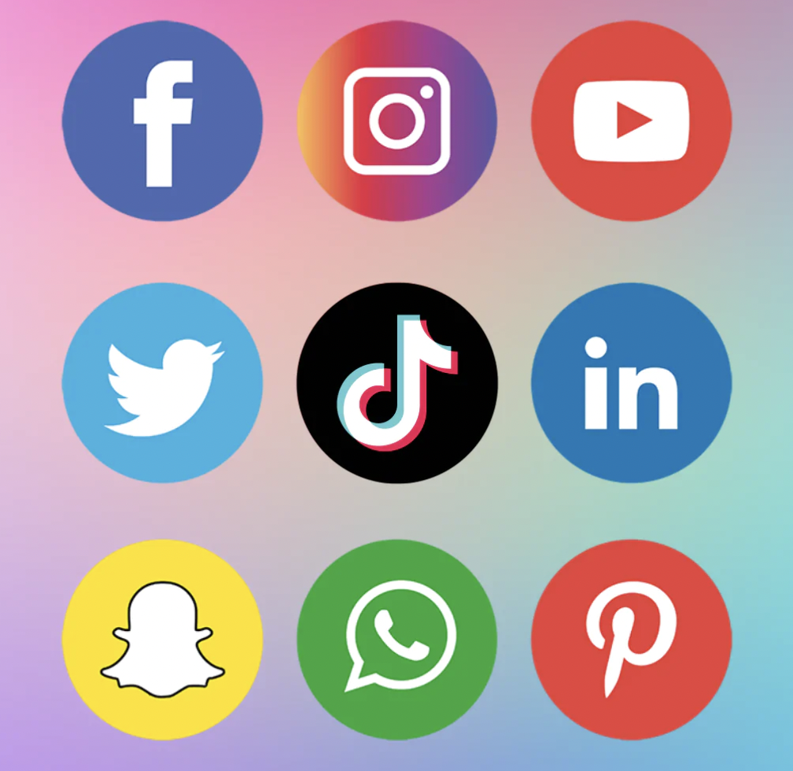
Summary of Social Media Campaign Description
Goal: To increase receptivity of St. Lucie county residents to FDOH public health messaging
Channels: Facebook, Instagram, Twitter, YouTube, TikTok, LinkedIn…etc
Content Schedule: Culturally appropriate content posted bi-weekly (videos, visual aids, messaging)
Monitoring & Evaluation Team: Receptivity to content will be evaluated and tailored as appropriate to ensure cultural competence and community engagement
Process Evaluation Team (follow-up): Through the life of the campaign data analytics will be collected to provide empirical evidence supporting the direction of next generation iterative campaign developments
Notes:
The development of the social media campaign is currently being spearheaded by the Florida Department of Health and Florida International University and should be available for beta testing earlier 2023.

Slide 14

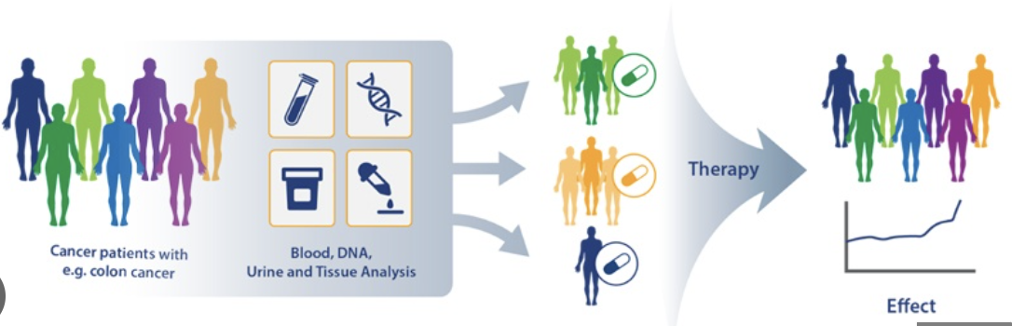
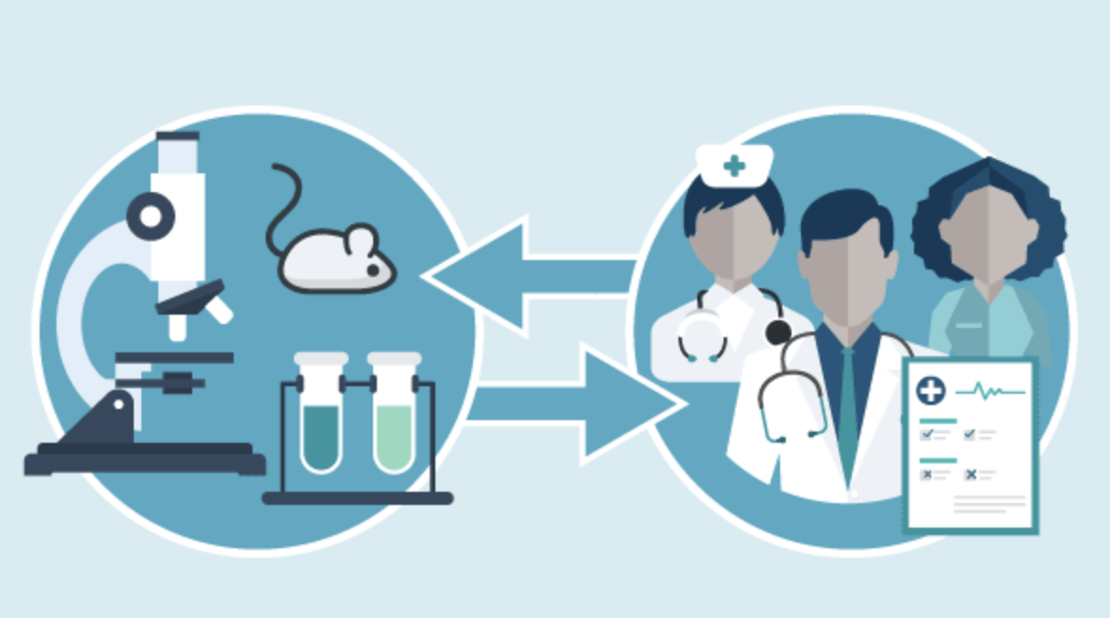
Dissertation Research Interests
Preclinical Research
Environmental and Molecular Determinants
Drug Development
Drug Delivery
Bioinformatics
Research Aims:
Aim 1: Environmental Determinants
Aim 2: Drug Development / Drug Delivery (Preclinical)
Aim 3: Molecular Determinants (Bioinformatics)
Aim 4: Research Commercialization
Precision Oncology
Notes:
I elect to focus my research efforts on identifying social determinants that alter gene expression leading to disease within minority communities. Theoretically, I could perform admixture mapping to detect gene expression patterns within the community and identify functional gene sets that co-vary with social determinants of health. I hypothesize differential expression of functional gene sets associated with communities with notable social inequality or poor social determinants.

Slide 15
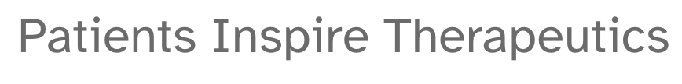
Learning objectives from Therapeutics Development Internship
Aim 4: Research Commercialization
Interdisciplinary Collaboration
Key Phases to IND Filing
Clinical Trial Design
Patient Population Selection
Identifying Therapeutic Disease Indications
Regulatory and Clinical Operations

Slide 16

Acknowledgements
23andMe:
Dr. Sophia Majeed, PhD
Olivia Luna
Schools of Public Health:
Dean Thomas LaVeist, PhD
Dr. Angela Breckenridge, PhD
Dean Tomas Guilarte, PhD
Dr. Deodutta Roy, PhD
Calico:
Dr. Ganesh Kolumam, PhD
Genentech:
Dr. Kimberly Scearce-Levie, PhD
Dr. Martin Weber, PhD
UC Davis MIND:
Dr. Jacqueline Crawley, PhD
Dr. Mu Yang, PhD

